Slide 1
Auto-documentation: Still A Dream
Elizabeth Wickes
Data Cleaning final project

Slide 2
Goal
Research data is complex
Researchers aren’t paid to document
Those who do take the time to document do so in sacrifice for other tasks
Project question:
Can some of this be automated?

Slide 3
Current automation: Data profiling tools
Yes Workflow kind of does this
Annotate scripts to create workflow/provenance documentation
documentation effort granularity matches the research activity
make pretty chart: discover beauty or terror
Open Refine
Poke through graphs, look at counts
Fix things, learn, and clean
sapply(dataframe, summary)
Quick and dirty method in R to generate summary statistics over all columns in a dataframe

Slide 4
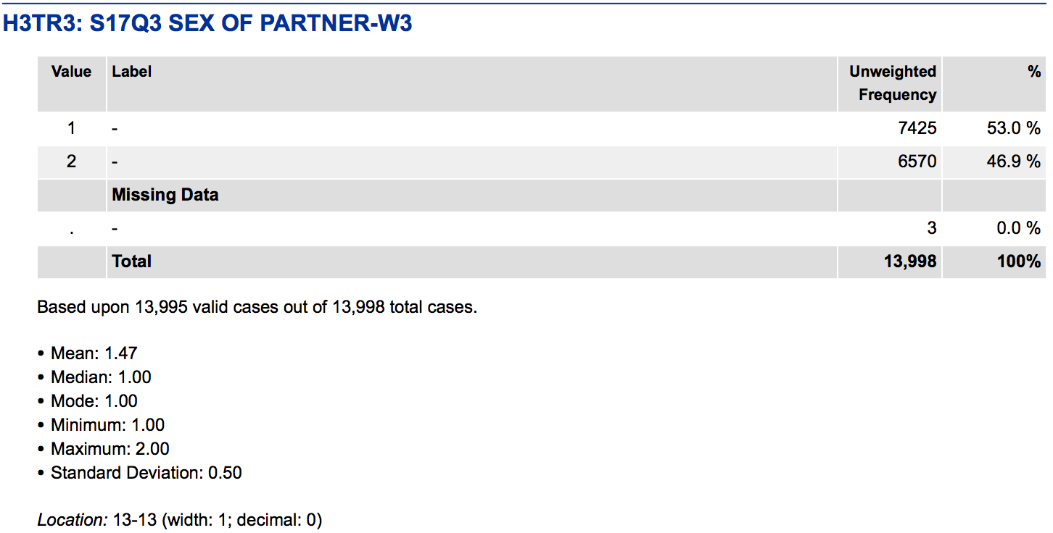
The beautiful world
Detect if data is categorical, ordinal, or continuous
Detect missing values
Create meaningful summary statistics
Basically, create ICPSR level codebooks via content aware algorithms

Slide 5
The Purpose
What can be automated?
Numbers (sorry humanists)
What can’t be automated?
Context
The valuable content to extract from a researcher is information on the context of questions
Goal: have the tool produce a basic readme template that the researcher can just fill information in.

Slide 6
Minimal proof of concept
Input?
CSV is the easiest and super common
Processing?
Numbers…
Focus on input
read in files, have slots for where to process things
have places for function additions
Focus on output
Going to produce very basic markup
Attempting to render that markup as HTML, but the basic options look odd

Slide 7
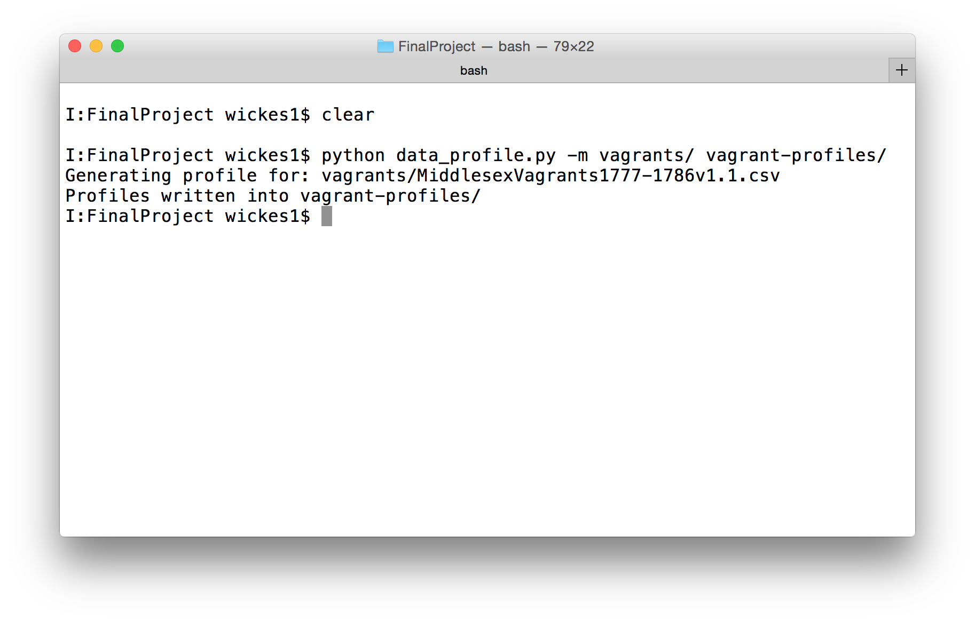
Basic use

Slide 8
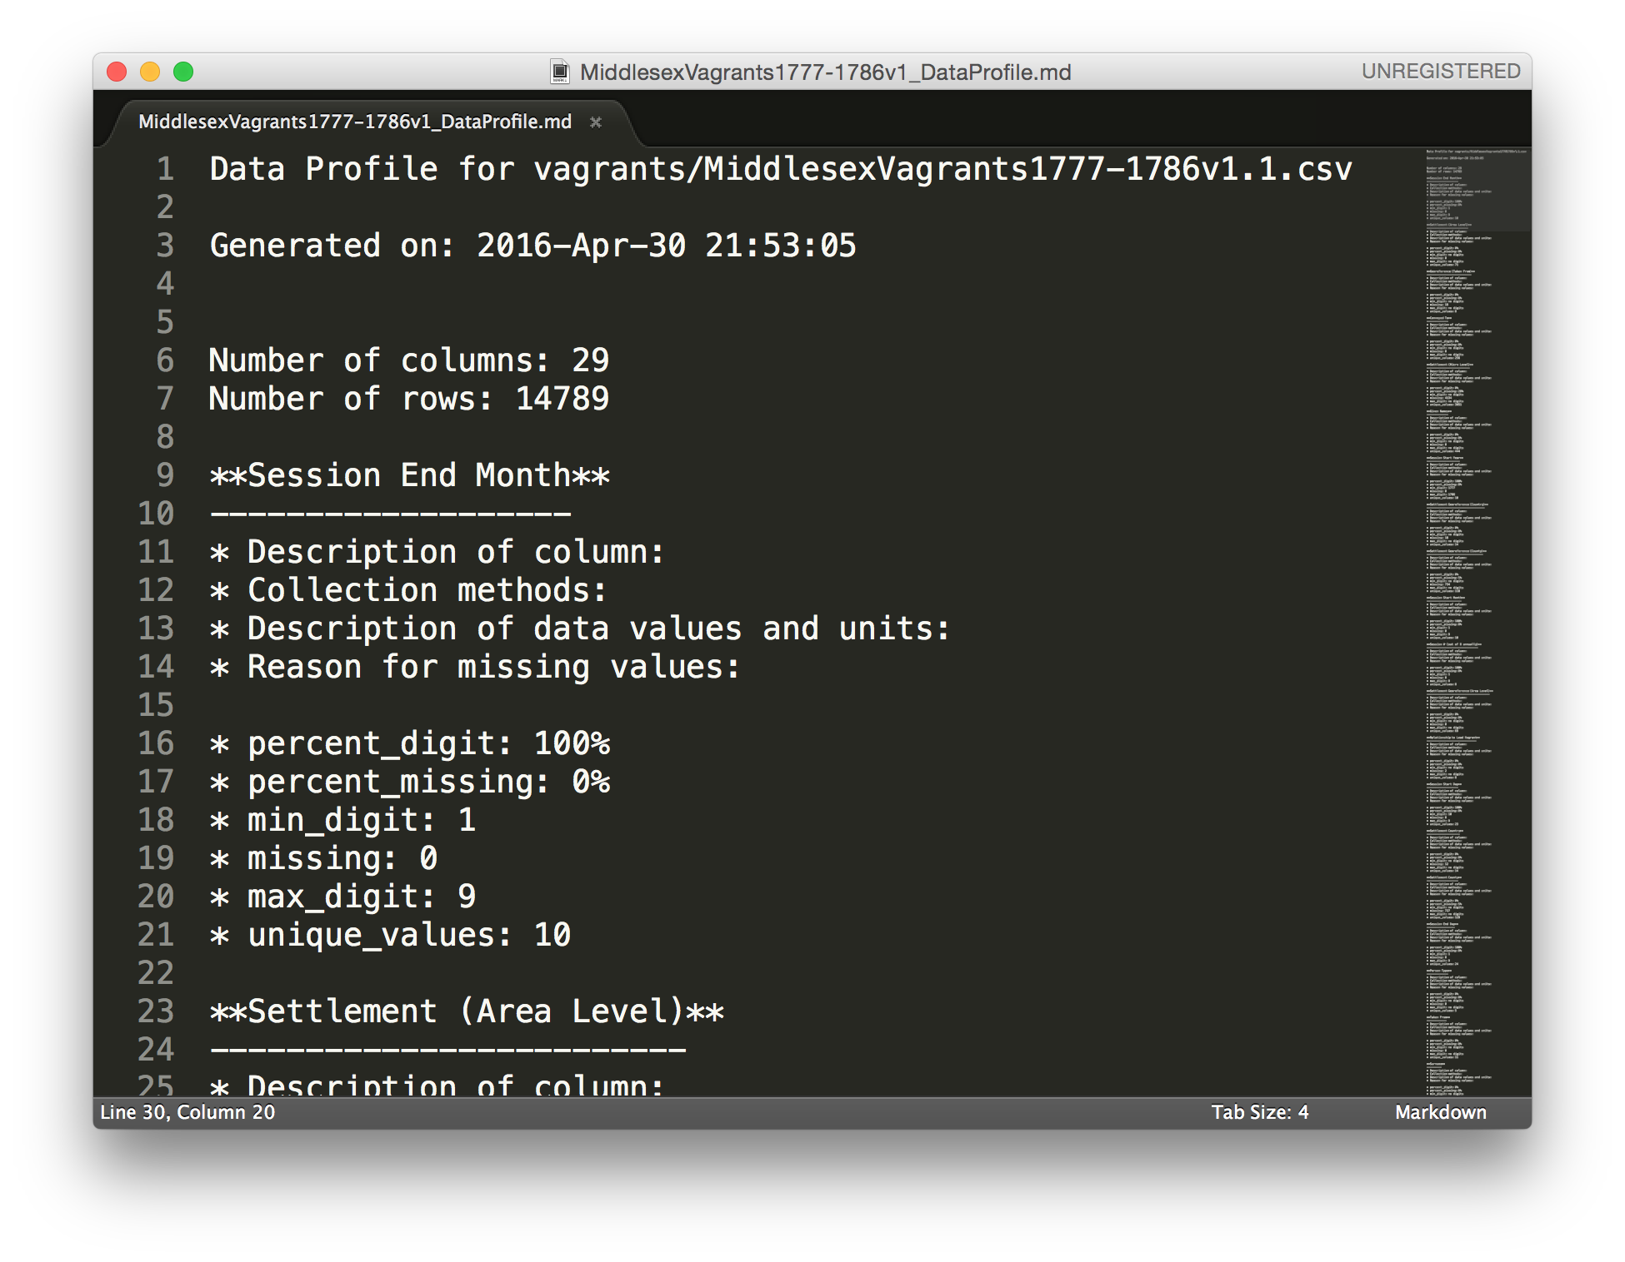
Basic use

Slide 9
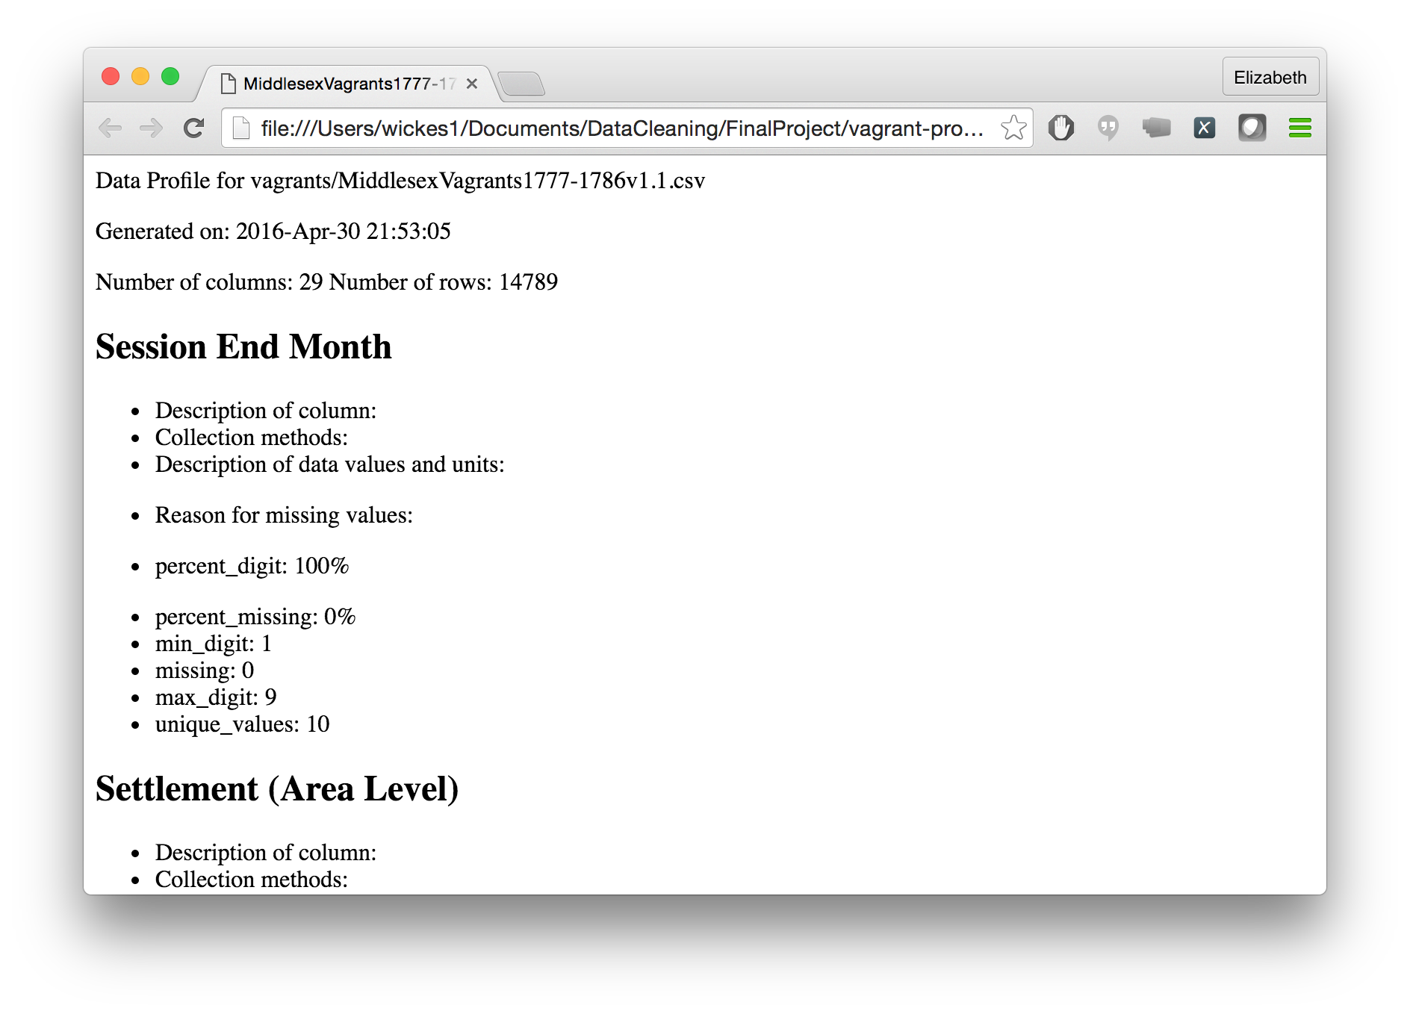
Basic use

Slide 10
Future TODOs
Have a template file that uses the format() method to add values
Some sort of web interface to prompt users to fill out the descriptive narrative
Handle additional data types

